Slide 1
Minor Project - II
Project Title : AI Virtual Painter
Name Subham Kewat
Project Number : PP-06

Slide 2
Content
Introduction
Key Features
Technologies used
Functioning of Application
Advantages
Outcomes
Conclusion
1

Slide 3
Introduction
Objective : To make a AI Virtual Painter which can paint from detecting our hands and gestures, with the help of utilizes computer vision techniques.
It is a software based program that allows users to input for painting and draw using gestures in device without using physical mouse and keyboard.
2

Slide 4
Key Features
Virtual Painter interface display on the screen.
Hands-free painting using motion detection.
Real-time interaction with a virtual painter.
Customizable for different tools and colors.
3

Slide 5
Technologies Used
Image Processing (OpenCV for real-time drawing and detection ).
GUI Development (Tkinter)
Hand Tracking Module (Mediapipe)
Numpy
Pynput
4

Slide 6
Functioning of Application
User
interface
Input
gesture
Hand tracking
Input processing
Output generation
5

Slide 7
Functioning of Application
User interface : Users interact application with attractive UI design.
Input gesture : This is the input layer where user interact with virtual painter and interpret the gesture as an input.
Hand tracking
Real time detection : Once the user place their hand within the interaction the system capture real time data about position and movement of the hands and fingers.
6

Slide 8
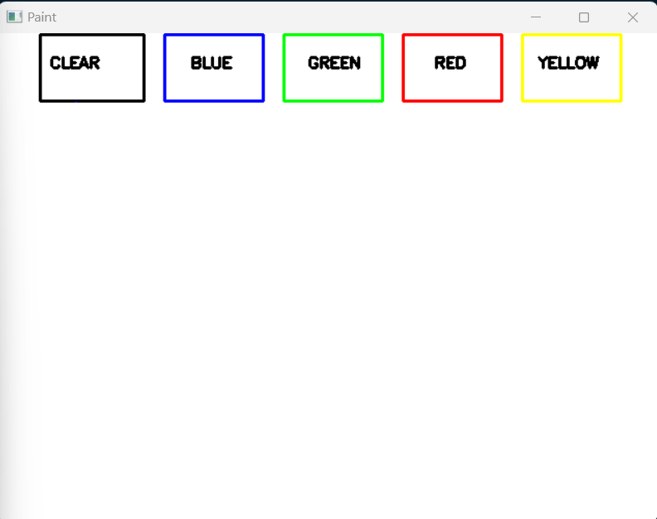
User Interface
7

Slide 9
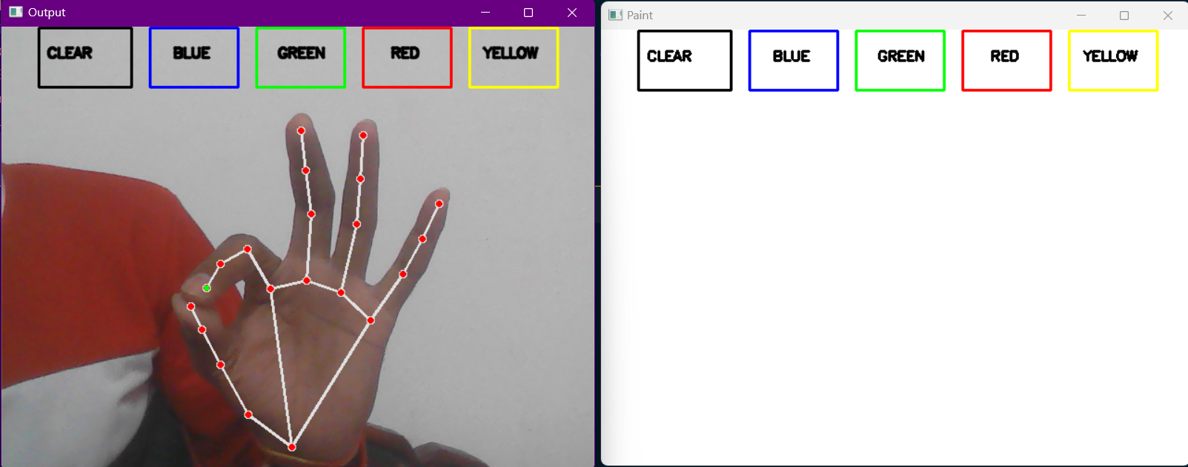
User Interface
8

Slide 10
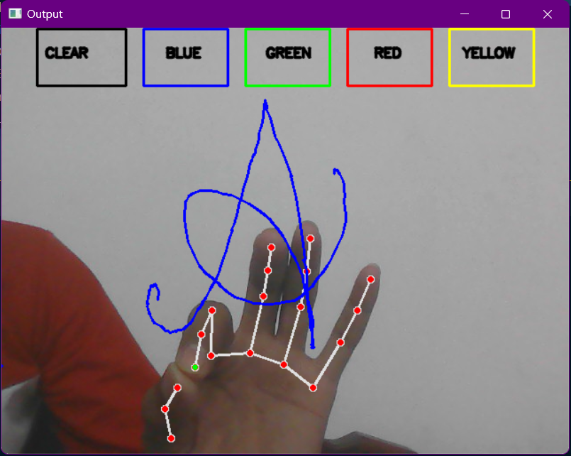
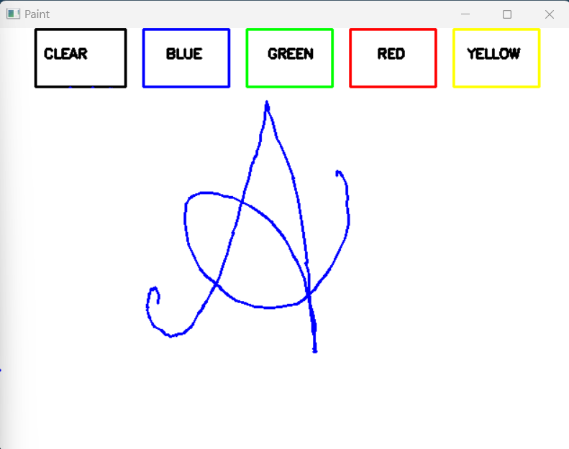
User Interface
9

Slide 11
Functioning of Application
Input processing : Interpretation of coordinates involve analysing and understanding the user coordinates and interprets gestures to control the painting tools.
Output generation : The recognize input based on hand tracking and coordination show on display.
10

Slide 12
Advantages
Touchless
Portability
Customizable
11

Slide 13
Outcomes
Contactless Solutions (Healthcare & Laboratories)
Interactive Gaming and Entertainment.
Improved accessibility for users with physical limitations.
12

Slide 14
Conclusion
The AI Virtual Painter project is developed to explore touchless, gesture-based interaction through hand tracking.
It could offer a new way for users especially artist to interact with technology in a more nature and effortless manner.
It has the potential to become a powerful tool for artists, also reduces the physical effort needed for traditional painting.
13

Slide 15
References
https://www.geeksforgeeks.org/opencv-python-tutorial/
https://www.w3schools.com/python/numpy/default.asp
https://python-forum.io/thread-40754.html
https://The Python Tutorial — Python 3.13.2 documentation
14

Slide 16
Thank You
15

